Slide 1

Agile Software Development (TCS 855)
Unit-II Agile Project Management
Agile Scrum Methodology
Prof.(Dr.) Santosh Kumar
Department of Computer Science and Engineering
Graphic Era Deemed to be University, Dehradun

Slide 2
Scrum Phases and Processes
Scrum processes address the specific activities and flow of a Scrum project. In total there are 19 processes in SBOK® Guide which are grouped into following five phases:
Initiate - This phase includes the processes related to initiation of a project: Create Project Vision, Identify Scrum Master and Stakeholder(s), Form Scrum Team, Develop Epic(s), Create Prioritized Product Backlog, and Conduct Release Planning.
Plan and Estimate -This phase consists of processes related to planning and estimating tasks, which include Create User Stories, Approve, Estimate, and Commit User Stories, Create Tasks, Estimate Tasks, and Create Sprint Backlog.
Implement - This phase is related to the execution of the tasks and activities to create a project's product. These activities include creating the various deliverables, conducting Daily Standup Meetings, and grooming (i.e., reviewing, fine-tuning, and regularly updating) the Product Backlog at regular intervals.
Review and Retrospect - This phase is concerned with reviewing the deliverables and the work that has been done and determining ways to improve the practices and methods used to do project work.
Release - This phase emphasizes on delivering the Accepted Deliverables to the customer and identifying, documenting, and internalizing the lessons learned during the project.

Slide 3
These phases describe each process in detail including the associated inputs, tools, and outputs of each. Following is the complete list of 19 Scrum processes, as described in SBOK® Guide.
Phase | Processes
Initiate | Create Project Vision Identify Scrum Master and Stakeholder(s) Form Scrum Team Develop Epic(s) Create Prioritized Product Backlog Conduct Release Planning
Plan and Estimate | 7. Create User Stories 8. Approve, Estimate, and Commit User Stories 9. Create Tasks 10. Estimate Tasks 11. Create Sprint Backlog
Implement | 12. Create Deliverables 13. Conduct Daily Standup 14. Groom Prioritized Product Backlog
Review and Retrospect | 15. Convene Scrum of Scrums 16. Demonstrate and Validate Sprint 17. Retrospect Sprint
Release | 18. Ship Deliverables 19. Retrospect Project

Slide 4
Initiate Phase Detailed descriptions
The Initiate phase consists of following six processes:
Create Project Vision - In this process, the Project Business Case is reviewed to create a Project Vision Statement that will serve as the inspiration and provide focus for the entire project. The Product Owner is identified in this process.
Identify Scrum Master and Stakeholder(s) - In this process, the Scrum Master and Stakeholders are identified using specific Selection Criteria.
Form Scrum Team - In this process, Scrum Team members are identified. Normally the Product Owner has the primary responsibility of selecting team members, but often does so in collaboration with the Scrum Master.
Develop Epic(s) - In this process, the Project Vision Statement serves as the basis for developing Epics. User Group Meetings may be held to discuss appropriate Epics.
Create Prioritized Product Backlog - In this process, Epic(s) are refined, elaborated, and then prioritized to create a Prioritized Product Backlog for the project. The Done Criteria is also established at this point.
Conduct Release Planning - Conduct Release Planning-In this process, the Scrum Core Team reviews the User Stories in the Prioritized Product Backlog to develop a Release Planning Schedule, which is essentially a phased deployment schedule that can be shared with the project stakeholders. Length of Sprint is also determined in this process.

Slide 5
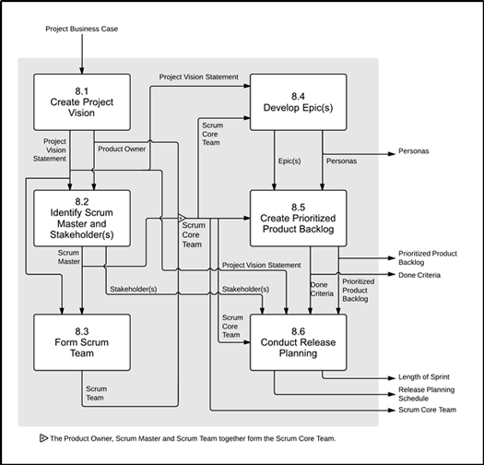
Following is the data flow diagram of the Initiate phase, broadly showing how different processes are connected to each other. For more details on different processes.

Slide 6
The Plan and Estimate The Plan and Estimate phase consists of following five processes:
Create User Stories - In this process, User Stories and their related User Story Acceptance Criteria are created. User Stories are usually written by the Product Owner and are designed to ensure that the customer's requirements are clearly depicted and can be fully understood by all stakeholders. User Story Writing Exercises may be held which involves Scrum Team members creating the User Stories. User Stories are incorporated into the Prioritized Product Backlog.
Approve, Estimate, and Commit User Stories - In this process, the Product Owner approves User Stories for a Sprint. Then, the Scrum Master and Scrum Team estimate the effort required to develop the functionality described in each User Story, and the Scrum Team commits to deliver the customer requirements in the form of Approved, Estimated, and Committed User Stories.
Create Tasks - In this process, the Approved, Estimated, and Committed User Stories are broken down into specific tasks and compiled into a Task List. Often a Task Planning Meeting is held for this purpose.
Estimate Tasks - In this process, the Scrum Core Team, in Task Estimation Meetings, estimate the effort required to accomplish each task in the Task List. The result of this process is an Effort Estimated Task List.
Create Sprint Backlog -In this process, the Scrum Core Team holds Sprint Planning Meetings where the group creates a Sprint Backlog containing all tasks to be completed in the Sprint.

Slide 7
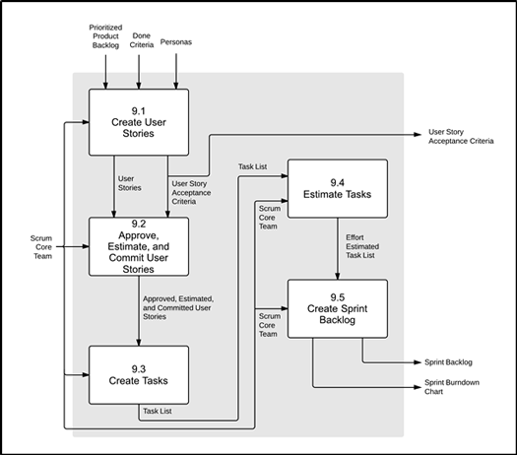
Following is the data flow diagram of the Plan and Estimate phase, broadly showing how different processes are connected to each other. For more details on different processes.

Slide 8
Implement The Implement phase consists of following three processes.
Create Deliverables - In this process, the Scrum Team works on the tasks in the Sprint Backlog to create Sprint Deliverables. A Scrumboard is often used to track the work and activities being carried out. Issues or problems being faced by the Scrum Team could be updated in an Impediment Log.
Conduct Daily Standup - In this process, everyday a highly focused, Time-boxed meeting is conducted referred to as the Daily Standup Meeting. This is the forum for the Scrum Team to update each other on their progress and any impediments they may be facing.
Groom Prioritized Product Backlog - In this process, the Prioritized Product Backlog is continuously updated and maintained. A Prioritized Product Backlog Review Meeting may be held, in which any changes or updates to the backlog are discussed and incorporated into the Prioritized Product Backlog as appropriate.

Slide 9
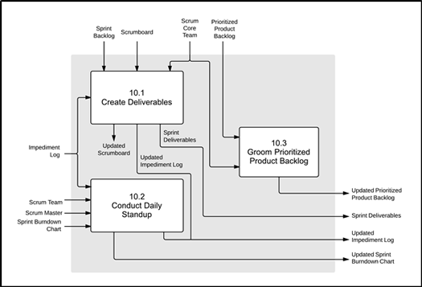
Following is the data flow diagram of the Implement phase, broadly showing how different processes are connected to each other. For more details on different processes.

Slide 10
Review and Retrospect
The Review and Retrospect phase consists of following three processes.
Convene Scrum of Scrums - In this process, Scrum Team representatives convene for Scrum of Scrums (SoS) Meetings in predetermined intervals or whenever required to collaborate and track their respective progress, impediments, and dependencies across teams. This is relevant only for large projects where multiple Scrum Teams are involved.
Demonstrate and Validate Sprint -In this process, the Scrum Team demonstrates the Sprint Deliverables to the Product Owner and relevant stakeholders in a Sprint Review Meeting. The purpose of this meeting is to secure approval and acceptance from the Product Owner for the Deliverables created in the Sprint.
Retrospect Sprint -In this process, the Scrum Master and Scrum Team meet to discuss the lessons learned throughout the Sprint. This information is documented as lessons learned which can be applied to future Sprints. Often, as a result of this discussion, there may be Agreed Actionable Improvements or Updated Scrum Guidance Body Recommendations.

Slide 11
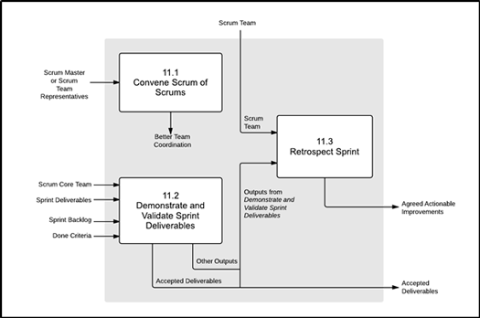
Following is the data flow diagram of the Review and Retrospect phase, broadly showing how different processes are connected to each other. For more details on different processes.

Slide 12
Release
The Release phase consists of following two processes.
Ship Deliverables - In this process, Accepted Deliverables are delivered or transitioned to the relevant stakeholders. A formal Working Deliverables Agreement documents the successful completion of the Sprint.
Retrospect Project - In this process, which completes the project, organizational stakeholders and Scrum Core Team members assemble to retrospect the project and identify, document, and internalize the lessons learned. Often, these lessons lead to the documentation of Agreed Actionable Improvements, to be implemented in future projects.

Slide 13
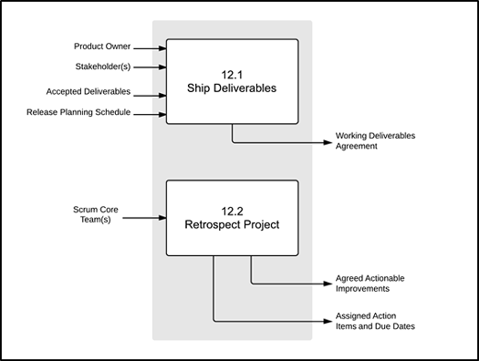
Following is the data flow diagram of the Release phase, broadly showing how different processes are connected to each other. For more details on different processes

